Slide 1
Image Approximation via Semi-Transparent Shape Evolution
Matteo Liotta
SM3800072
Optimization for Artificial Intelligence, 2025, UniTS - Final Project

Slide 2
Problem Introduction
Notes:
-i.e. Gliomas and Glioblastomas-

Slide 3

Problem Introduction
This project is a revisit of the “Genetic-lisa” Peter Braden’s project, which aims to recreate images with genetic algorithms., which had different implementations over time, from Python to C
The base concept is to evolve an image, defined an obtained as a series of overlapping shapes, together with
(shape and color) mutation
natural selection
Crossover
in order to reach a certain level of similitude with the original picture.
Notes:
-i.e. Gliomas and Glioblastomas-

Slide 4
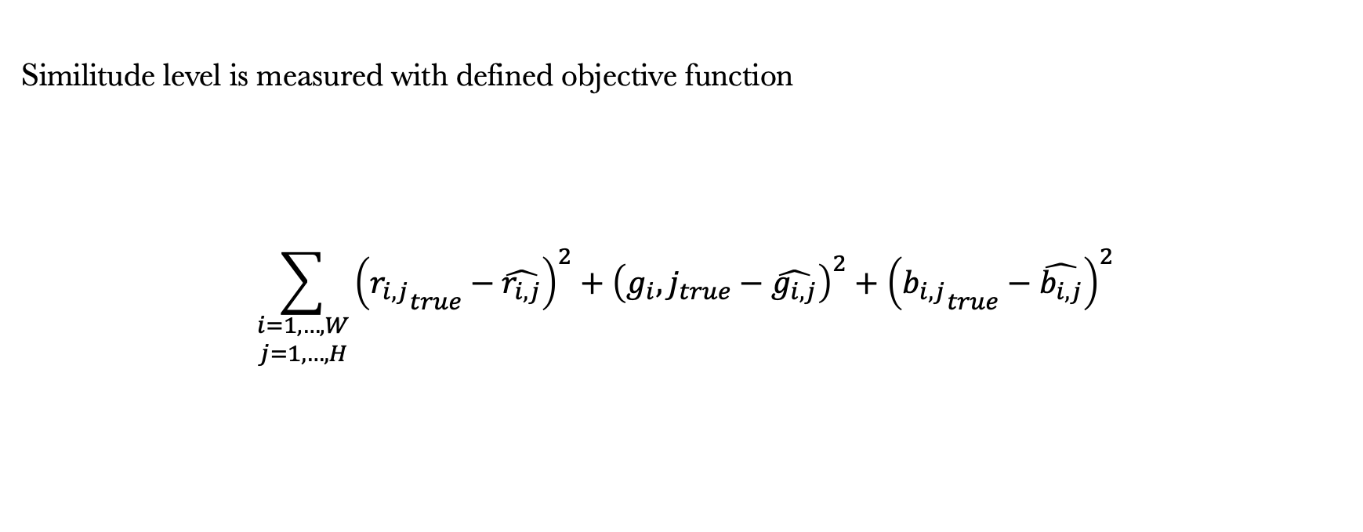
Problem Introduction
Similitude level is measured with defined objective function
$$\sum_{\begin{matrix}i=1,…,W \\ j=1,…,H\end{matrix}}{{\left({r_{i,j}}_{true}−\hat{r_{i,j}}\right)}^{2}+{\left({g_{i},j}_{true}−\hat{g_{i,j}}\right)}^{2}+{\left({b_{i,j}}_{true}−\hat{b_{i,j}}\right)}^{2}}$$
Notes:
-i.e. Gliomas and Glioblastomas-

Slide 5
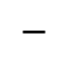
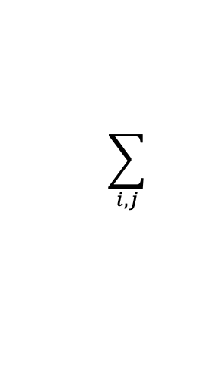
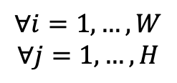
Problem Introduction
Similitude level is measured with defined objective function
(
)
2
$$\sum_{i,j}{ }$$
$$∀i=1,…,W$$
$$∀j=1,…, H$$
$$−$$
Reference
Evol. Image
( i,j )
Notes:
-i.e. Gliomas and Glioblastomas-

Slide 6
How are individuals defined?
Notes:
-i.e. Gliomas and Glioblastomas-

Slide 7
How are individuals defined?
Shapes
Color
Notes:
-i.e. Gliomas and Glioblastomas-

Slide 8
How are individuals defined?
Shape Definition
In the original code different shapes are proposed, but here we can focus on
Ellipses
Rectangle
Triangles
defined as a dictionary of name and coordinates
{'type': 'triangle', 'coords': [44, 213, 93, 148, 163, 220]}
Notes:
Those should be enough to capture the image details

Slide 9
How are individuals defined?
Shape Definition
In the original code different shapes are proposed, but here we can focus on
Ellipses
Rectangle
Triangles
defined as a dictionary of name and coordinates
{'type': 'triangle', 'coords': [44, 213, 93, 148, 163, 220]}
(x,y)
(x,y)
(x,y)
Notes:
Those should be enough to capture the image details

Slide 10
How are individuals defined?
Shape Definition
In the original code different shapes are proposed, but here we can focus on
Ellipses
Rectangle
Triangles
defined as a dictionary of name and coordinates
{'type': 'rectangle', 'coords': [31, 136, 48, 160]}
{'type': ‘ellispes', 'coords': [31, 136, 48, 160]}
Notes:
Those should be enough to capture the image details

Slide 11
How are individuals defined?
Shape Definition
In the original code different shapes are proposed, but here we can focus on
Ellipses
Rectangle
Triangles
defined as a dictionary of name and coordinates
y
y + shape heigth
{'type': 'rectangle', 'coords': [31, 136, 48, 160]}
{'type': ‘ellispes', 'coords': [31, 136, 48, 160]}
x
x + shape width
Notes:
Those should be enough to capture the image details

Slide 12
Shape Color Definition
Also color could be generated, but the original code introduced (and didn’t used) the prev input
def generate_color(prev = None, a_mutation = (-0x5,0x3), rgb_mutation = (-0x5,0x3)):
if prev:
return (prev[0] + random.randint(*a_mutation), # R
prev[1] + random.randint(*rgb_mutation), # G
prev[2] + random.randint(*rgb_mutation), # B
prev[3] + random.randint(*rgb_mutation)) # A
return (random.randint(0x33, 0x99), # R
random.randint(0, 0xff), # G: between 0 and 255
random.randint(0, 0xff), # B: between 0 and 255
random.randint(0, 0xff)) # A: between 0 and 255
Notes:
-i.e. Gliomas and Glioblastomas-

Slide 13
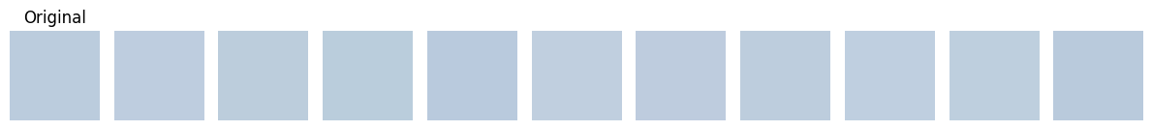
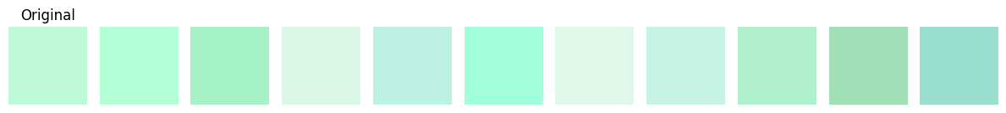
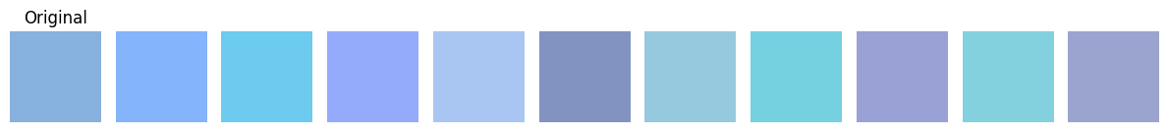
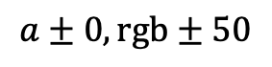
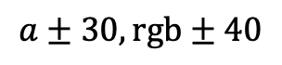
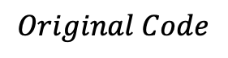
Shape Color Definition
As we’ll see later on, this will be used inside the indidual shape mutation, since using the prev parameter we can mutate the color and not generate it from zero…
… But here additional range parameters has been introduced for better mutation performances
$$Original Code$$
$$a±0,rgb±50$$
$$a±30,rgb±40$$
Notes:
-i.e. Gliomas and Glioblastomas-

Slide 14
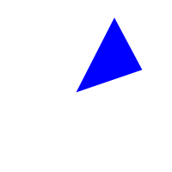

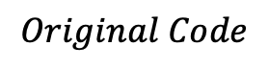
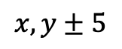
…Back to shape definition
This idea can be proposed inside the shape definition function, since in this way shapes under change in mutation… can be modified instead of deleted and randomly substituted
$$Original Code$$
$$x,y±5$$
Notes:
-i.e. Gliomas and Glioblastomas-

Slide 15
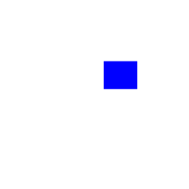

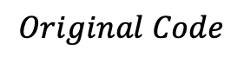
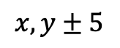
…Back to shape definition
This idea can be proposed inside the shape definition function, since in this way shapes under change in mutation… can be modified instead of deleted and randomly substituted
$$Original Code$$
$$x,y±5$$
Notes:
-i.e. Gliomas and Glioblastomas-

Slide 16


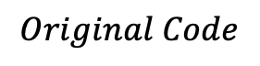
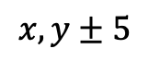
…Back to shape definition
This idea can be proposed inside the shape definition function, since in this way shapes under change in mutation… can be modified instead of deleted and randomly substituted
$$Original Code$$
$$x,y±5$$
Notes:
-i.e. Gliomas and Glioblastomas-

Slide 17
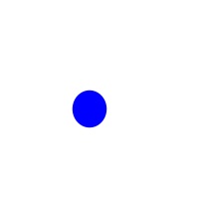

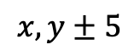
…Back to shape definition
This idea can be proposed inside the shape definition function, since in this way shapes under change in mutation… can be modified instead of deleted and randomly substituted
$$Original Code$$
$$x,y±5$$
Notes:
-i.e. Gliomas and Glioblastomas-

Slide 18
Individuals
The original code proposed a Strain Class to handle
Genotype of individuals creation
Crossover for individual creation from parents
Mutation
This leads to…
Notes:
-i.e. Gliomas and Glioblastomas-

Slide 19
Individuals
This leads to…
Genotype
Name
Dna
Fitness value
list of dictionaries of {shapes: {type, coordinates}, colors : color tuple}
Notes:
-i.e. Gliomas and Glioblastomas-

Slide 20
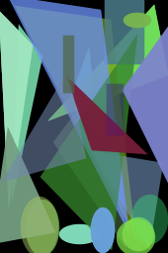
Individuals
This leads to…
Genotype
Name
Dna
Fitness value
Fenotype
Notes:
-i.e. Gliomas and Glioblastomas-

Slide 21
Evolutionary cycle
Notes:
-i.e. Gliomas and Glioblastomas-

Slide 22
Evolutionary cycle
Population Initialization
Notes:
Those should be enough to capture the image details

Slide 23
Population Initialization
Parents
Crossover
Additional 10 individuals
Notes:
Those should be enough to capture the image details

Slide 24
Population Initialization
Parents
Crossover
Mutation
Additional 10 individuals
Of the 10 additional individuals
Notes:
Those should be enough to capture the image details

Slide 25
Population Initialization
Parents
Crossover
Mutation
Selection
Additional 10 individuals
Of the 10 additional individuals
Select 5 over 15
Notes:
Those should be enough to capture the image details

Slide 26
Population Initialization
Parents
Crossover
Mutation
Selection
Additional 10 individuals
Of the 10 additional individuals
Select 5 over 15
Notes:
Those should be enough to capture the image details

Slide 27
How is crossover defined?
Notes:
-i.e. Gliomas and Glioblastomas-

Slide 28
How is crossover defined?
Each individual has its own dna, defined of atomic units: the genes
i-th gene
Notes:
Those should be enough to capture the image details

Slide 29
How is crossover defined?
i-th gene
Shape type and
coordinates
Shape color
Notes:
Those should be enough to capture the image details

Slide 30
How is crossover defined?
Individual dna
Notes:
Those should be enough to capture the image details

Slide 31
How is crossover defined?
We start with a parent population, where each individual has its dna.
To generate a new individual we select randomly a parent dna and deepcopy it.
Parent 1
Parent 2
Parent 3
Notes:
Those should be enough to capture the image details

Slide 32
How is crossover defined?
Then we iterate on the number of parents
Notes:
Those should be enough to capture the image details

Slide 33
How is crossover defined?
And change one random gene of in place of another gene of the new individual
Parent 1
Parent 2
Parent 3
Notes:
Those should be enough to capture the image details

Slide 34
How is crossover defined?
Parent 1
Parent 2
Parent 3
Notes:
Those should be enough to capture the image details

Slide 35
How is crossover defined?
Parent 1
Parent 2
Parent 3
Notes:
Those should be enough to capture the image details

Slide 36
How is crossover defined?
Parent 1
Parent 2
Parent 3
Notes:
Those should be enough to capture the image details

Slide 37
How is crossover defined?
Parent 1
Parent 2
Parent 3
Notes:
Those should be enough to capture the image details

Slide 38
How is crossover defined?
Then we iterate on the number of parents
Parent 1
Parent 2
Parent 3
Notes:
Those should be enough to capture the image details

Slide 39
How is crossover defined?
Parent 1
Parent 2
Parent 3
Notes:
Those should be enough to capture the image details

Slide 40
How is crossover defined?
After that, mutation will occur to each new obtained individual.
Notes:
Those should be enough to capture the image details

Slide 41
How is mutation defined?
Notes:
-i.e. Gliomas and Glioblastomas-

Slide 42
Individuals
The mutation occurs after the crossover to those new individuals.
The idea is to introduce three different actions:
New random shape appending to offsprings DNA
Shape change and color change of a gene
Random shape removal to offspring DNA
As introduced before, the change function has been changed: now we don’t change a shape by deletion and random reinsertion, but deletion and conditionate reinsertion.
len<500 and 25% probability
elif 75% probability
else
Notes:
-i.e. Gliomas and Glioblastomas-

Slide 43
(modified*) Original way: performances and results
* Changed mutation, reduced shape size, numpy fitness alternative
Notes:
-i.e. Gliomas and Glioblastomas-

Slide 44
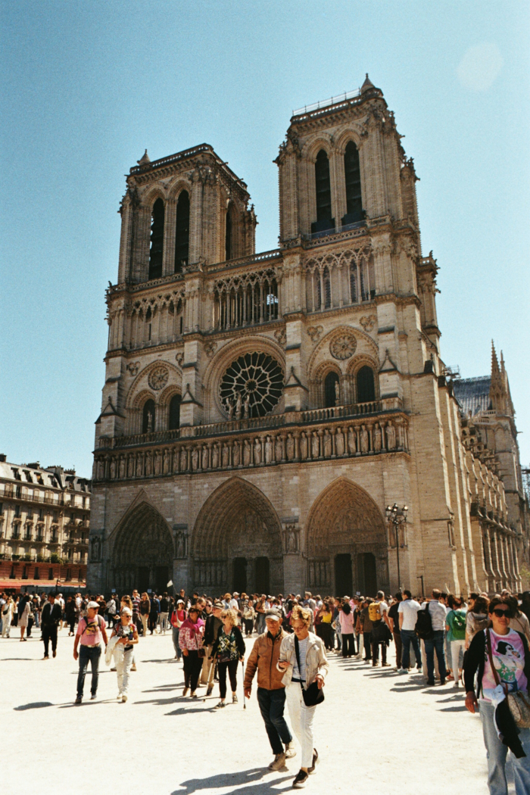
Example on Notre Dame
The example picture is a Notre Dame colored image I took this year in Paris.
The population initial parameters were
Image_size: 170 x 256
Generation_population: 10
Crossover_population: 5
Over 30000 epochs.
Notes:
-i.e. Gliomas and Glioblastomas-

Slide 45
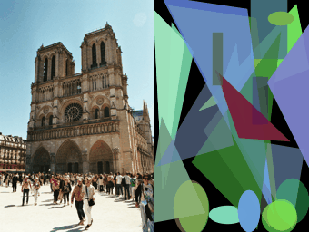
Example on Notre Dame
The example picture is a Notre Dame colored image I took this year in Paris.
The population initial parameters were
Image_size: 170 x 256
Generation_population: 10
Crossover_population: 5
Over 30000 epochs.
Notes:
-i.e. Gliomas and Glioblastomas-

Slide 46
Example on Notre Dame
Result is good, but even if numpy futness evaluation, time is a problem that limits the performances: image need to be evaluated each time.
This leads another new approach…
Notes:
-i.e. Gliomas and Glioblastomas-

Slide 47
How can we speed up evolution?
Multiprocessing patches
evolution
Fitness simplification
Notes:
-i.e. Gliomas and Glioblastomas-

Slide 48
Patches idea introduction
The main idea is to take advantage of multi-core processing. Notice this is related to the number of cores available
We would have many advantages:
Each core could handle evolution independently on a sub part of the image (patch)
Since shape sizes are canvas related, more precision should be present
We should notice a speed increase since fitness evaluations would be on smaller images, proportional to the number of cores
Over same number of epochs we end up with core-number times more shapes
No assumptions or reduced set of shapes and colors
…and resulting patches could be attached together at the end.
Notes:
-i.e. Gliomas and Glioblastomas-

Slide 49
Patches idea introduction
The main idea is to take advantage of multi-core processing. Notice this is related to the number of cores available
We would have many advantages:
Each core could handle evolution independently on a sub part of the image (patch)
Since shape sizes are canvas related, more precision should be present
We should notice a speed increase since fitness evaluations would be on smaller images, proportional to the number of cores
Over same number of epochs we end up with core-number times more shapes
No assumptions or reduced set of shapes and colors
+ Now we can measure shape sizes with a parameter
Notes:
-i.e. Gliomas and Glioblastomas-

Slide 50
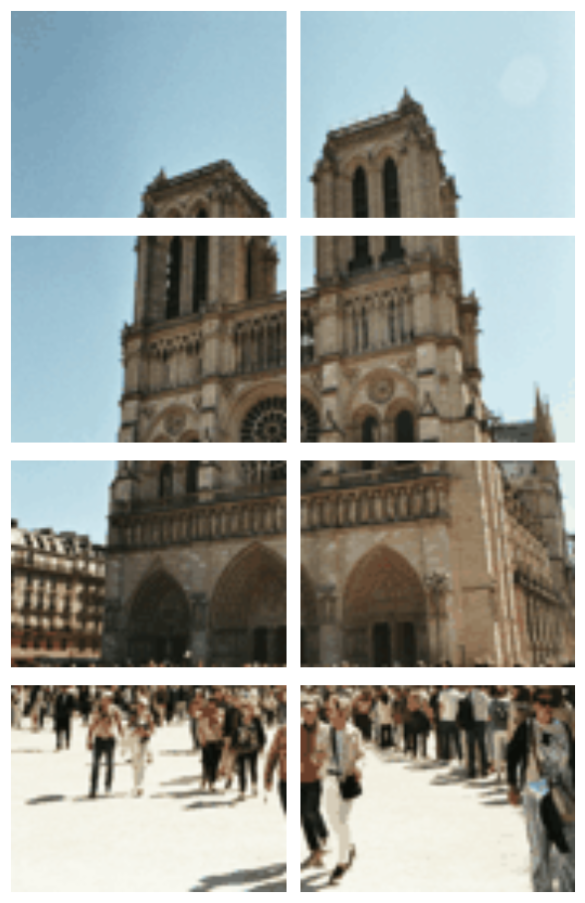
Patches idea introduction
#cores = 8
Notes:
-i.e. Gliomas and Glioblastomas-

Slide 51
Fitness function revisited
We can define an alternative fitness which is the L1 norm:
def fitness(self):
return self._fitness or self._fitness_func()
def _fitness_func(self):
ref_img = self.reference_image.convert("RGBA")
draw_img = np.array(self.draw().convert("RGBA"), dtype=np.int16)
ref_img = np.array(ref_img, dtype=np.int16)
diff = draw_img[:, :, :3] - ref_img[:, :, :3]
fitness = np.sum(np.abs(diff))
self._fitness = fitness
return fitness
Notes:
-i.e. Gliomas and Glioblastomas-

Slide 52
Modified way: (compared) performances and results
Notes:
-i.e. Gliomas and Glioblastomas-

Slide 53
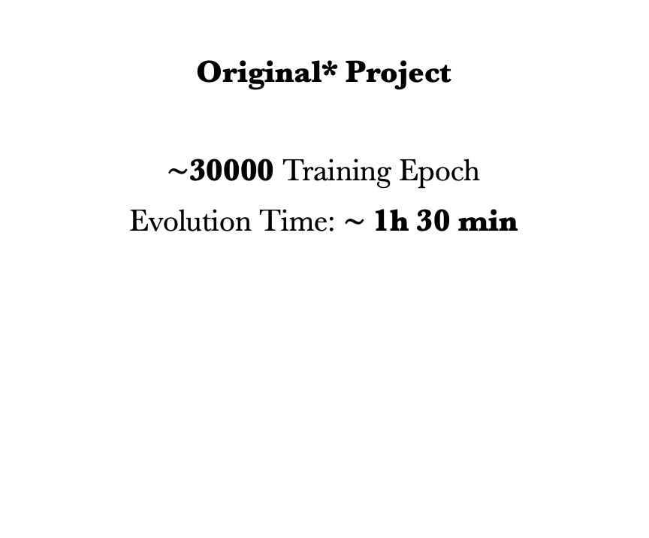
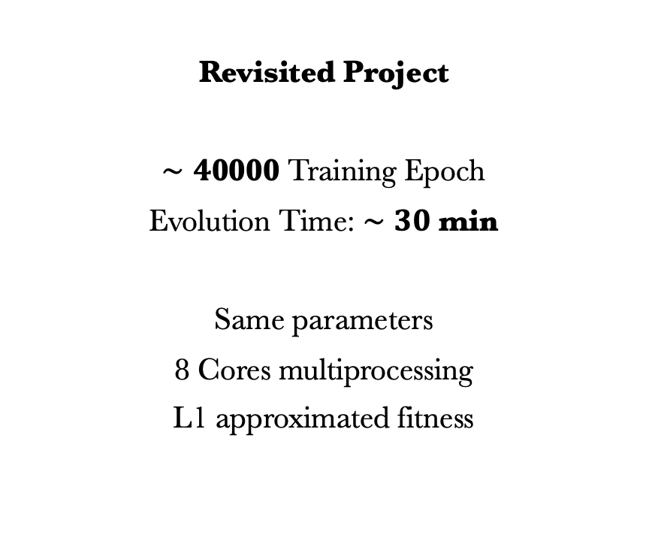
Time comparison
Original* Project
$∼$30000 Training Epoch
Evolution Time: $∼$1h 30 min
Revisited Project
$∼4$0000 Training Epoch
Evolution Time: $∼30$ min
Same parameters
8 Cores multiprocessing
L1 approximated fitness
Notes:
-i.e. Gliomas and Glioblastomas-

Slide 54
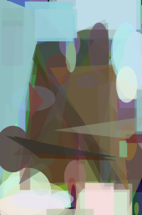
Time comparison
Original*
Reference
Revisited
Notes:
-i.e. Gliomas and Glioblastomas-

Slide 55
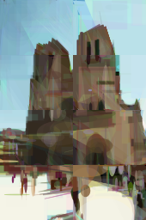
Time comparison
Original*
Reference
Revisited
Notes:
-i.e. Gliomas and Glioblastomas-

Slide 56
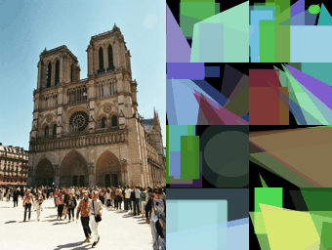
Notes:
-i.e. Gliomas and Glioblastomas-

Slide 57
What about other images?
Shape size reduction
ratio*
Shape size ratio* scheduling
* w.r.t. image size
Notes:
-i.e. Gliomas and Glioblastomas-

Slide 58
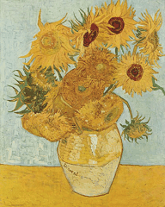
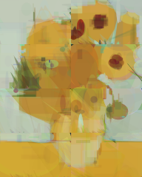
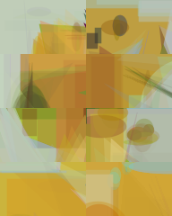
Time comparison
Reference
Small Shapes Evolution
1000 epochs
Big Shapes Evolution
1000 epochs
Notes:
-i.e. Gliomas and Glioblastomas-

Slide 59
Time comparison
RIFAI
Reference
Small Shapes Evolution
30000 epochs
Notes:
-i.e. Gliomas and Glioblastomas-

Slide 60
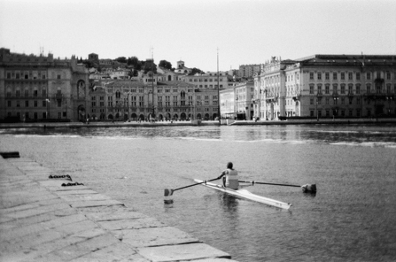
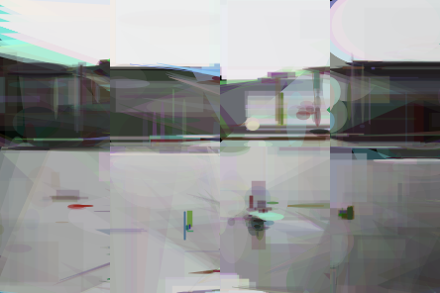
Time comparison
RIFAI
Reference
Small (ratio 22) Shape Evolution
30000 epochs
Notes:
-i.e. Gliomas and Glioblastomas-

Slide 61
Final Notre Dame visual comparison
Notes:
-i.e. Gliomas and Glioblastomas-

Slide 62
Time comparison
Original*
Reference
Revisited
Small shape revisited
Evolution over 30000 epochs
Notes:
-i.e. Gliomas and Glioblastomas-

Slide 63
Project References
[1] The evolution of a Smile, Peter Braden: https://github.com/peterbraden/genetic-lisa/
[2] Mona Lisa Gif Evolution: https://github.com/peterbraden/genetic-lisa/blob/master/images/lisa-anim.gif
[3] Vase with Twelve Sunflowers (Arles, August 1888), Van Gogh. Neue Pinakothek, Munich: https://commons.wikimedia.org/wiki/File:Vincent_Willem_van_Gogh_128.jpg
[4] La persistenza della memoria, Dalì: https://www.analisidellopera.it/wp-content/uploads/2018/10/Dali_La_persistenza_della_memoria-1.jpg

